Slide 1

LUDIC ARTISTS
To enthrall people with our orphic work towards mars !

Slide 2
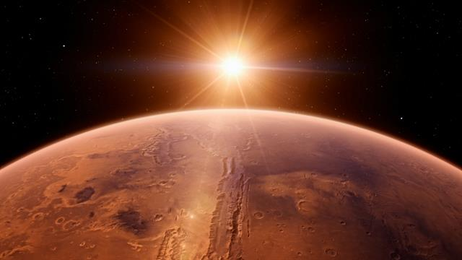
MILLIONS OF YEARS AGO

Slide 3
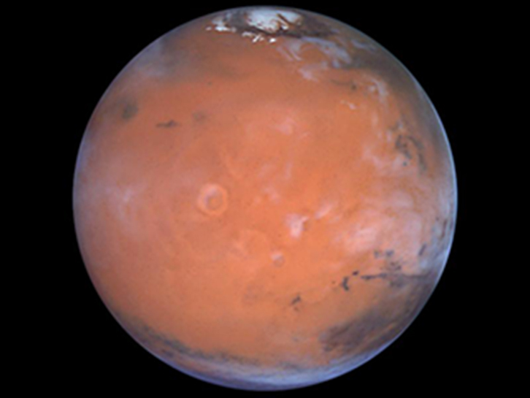

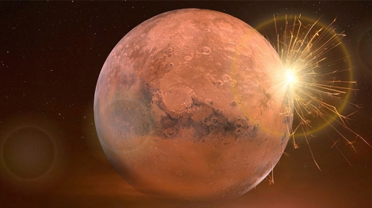
HOW MARS WAS AFFECTED AND HOW IT WAS AT THE VERGE OF DESTRUCTION !

Slide 4
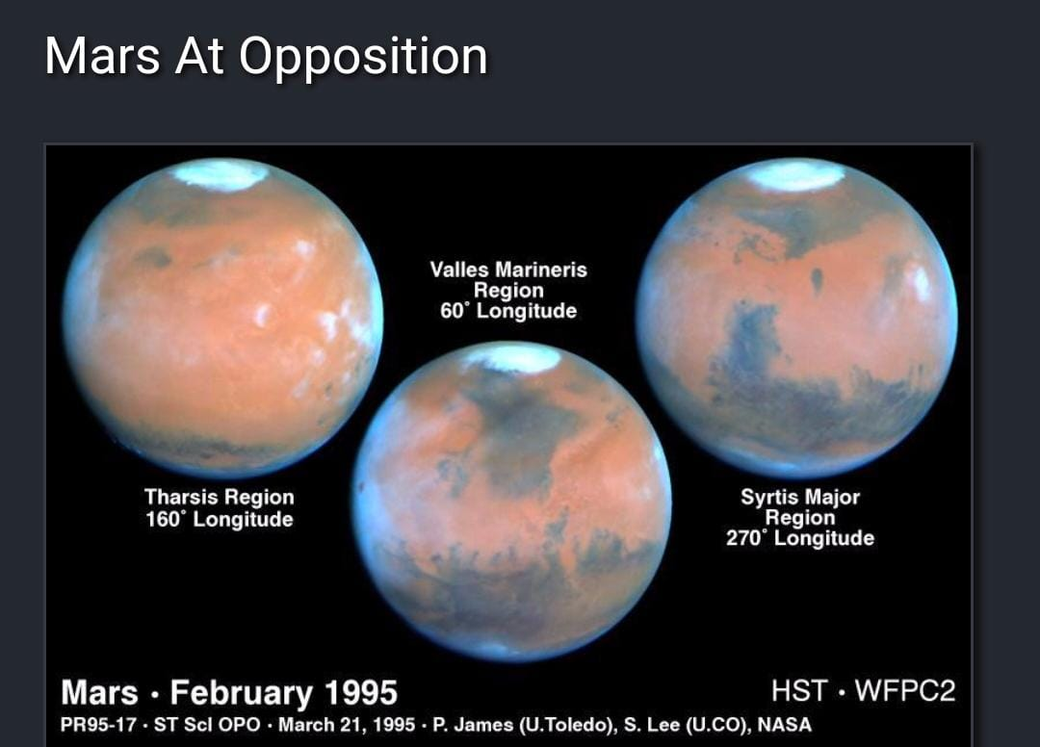
By definition, a “Mars opposition” occurs when planet Earth passes in between the Sun and planet Mars. The term refers to the fact that Mars and the Sun appear on opposite sides of the sky. Because of their orbits, Mars oppositions happens about every 2 years and 2 months – 779.94 Earth days to be precise.

Slide 5
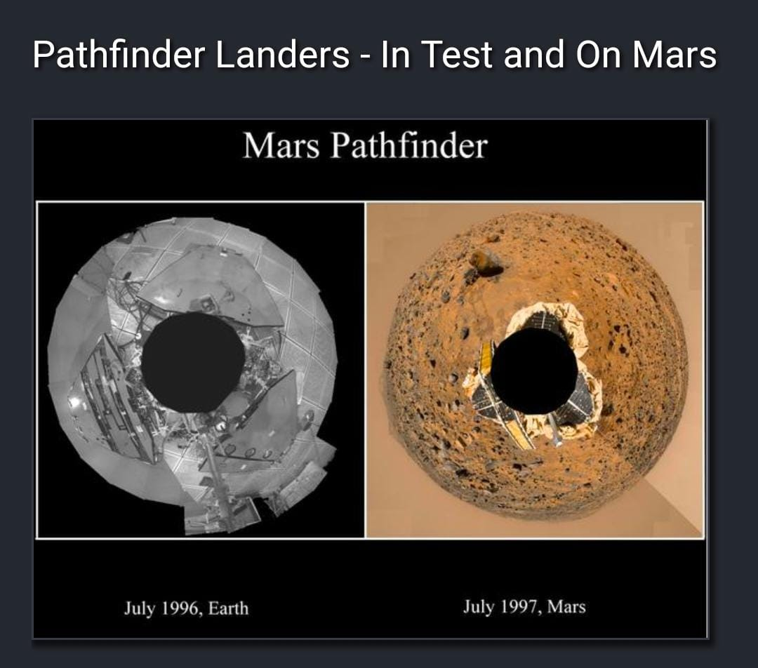
MISSION OBJECTIVES
To prove that the development of "faster, better and cheaper" spacecraft was possible .
To show that it was possible to send a load of scientific instruments to another planet with a simple system and at one-fifteenth the cost of a Viking mission.

Slide 6

PRESENT RESEARCH WORKS

Slide 7
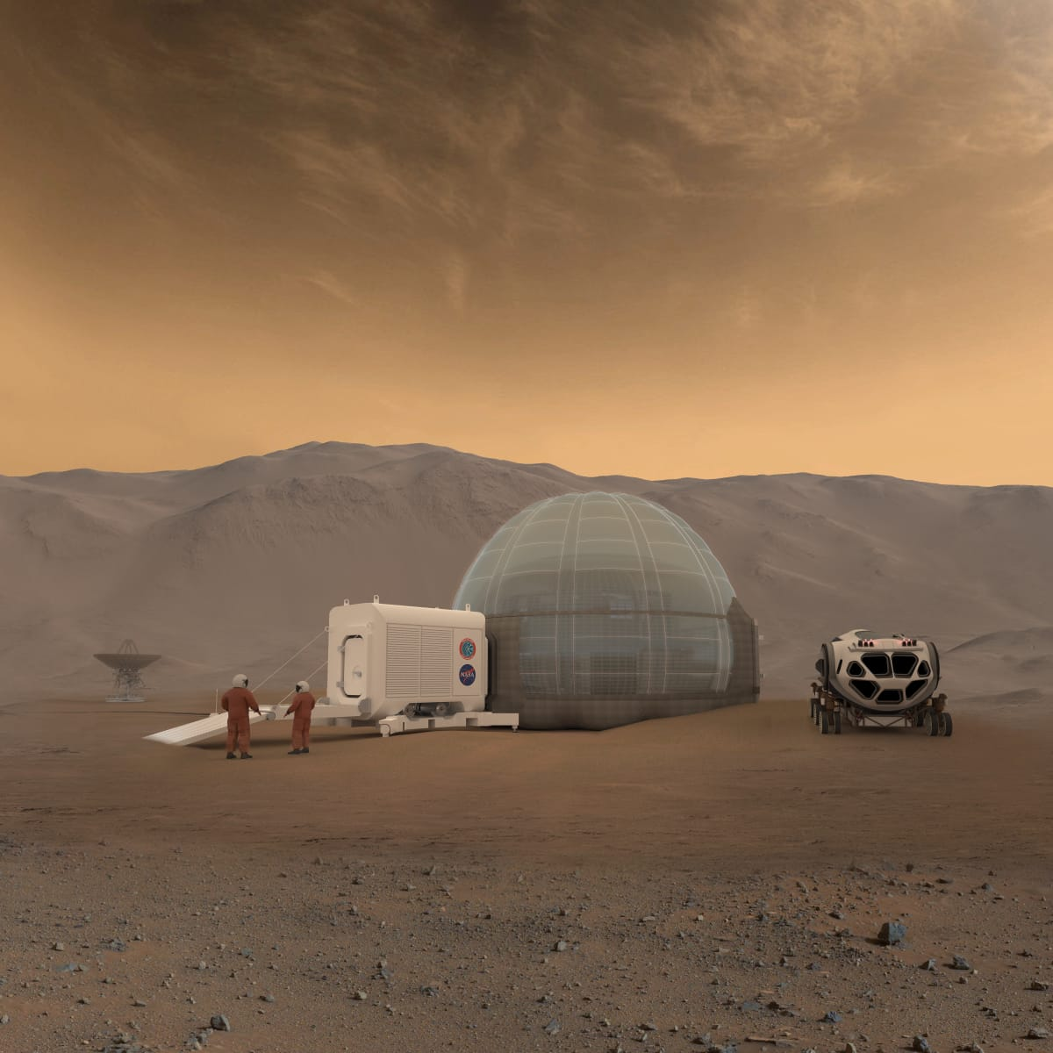
Mars Ice Home is a feasibility study conducted at NASA Langley Research Center in 2016 in collaboration with SEArch+ and CloudsAO. Mars Ice Home is a collaborative project with NASA Langley Research Center to develop a feasibility study for a habitat made of ice on Mars. ... The water-ice fills and freezes within cellular pockets of the precision-manufactured inflatable membrane.

Slide 8
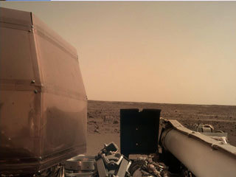
InSight is a Mars lander designed to give the Red Planet its first thorough checkup since it formed 4.5 billion years ago. InSight landed on Mars on November 26, 2018.

Slide 9
NASA's Ingenuity Mars Helicopter will make history's first attempt at powered flight on another planet next spring. It is riding with the agency's next mission to Mars (the Mars 2020 Perseverance rover) as it launches from Cape Canaveral Air Force Station later this summer. Perseverance, with Ingenuity attached to its belly, will land on Mars February 18, 2021. As a technology demonstration, Ingenuity is testing a new capability for the first time: showing controlled flight is possible in the very thin Martian atmosphere. If successful, Ingenuity could lead to an aerial dimension to space exploration, aiding both robots and humans in the future.

Slide 10
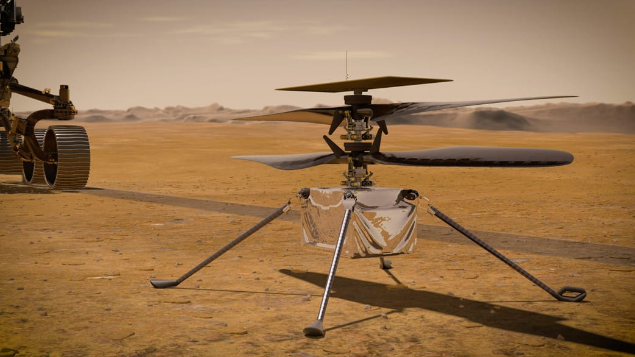

Slide 11
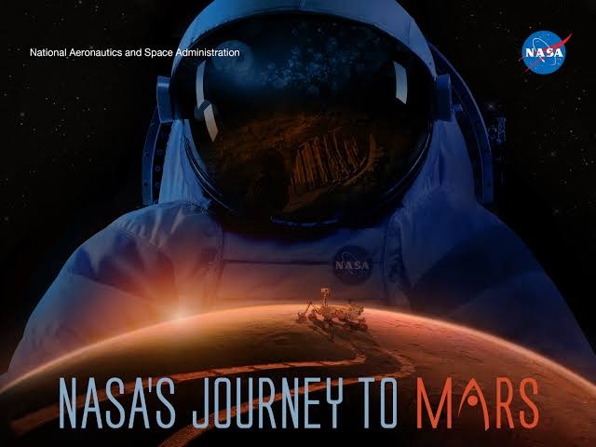

Slide 12
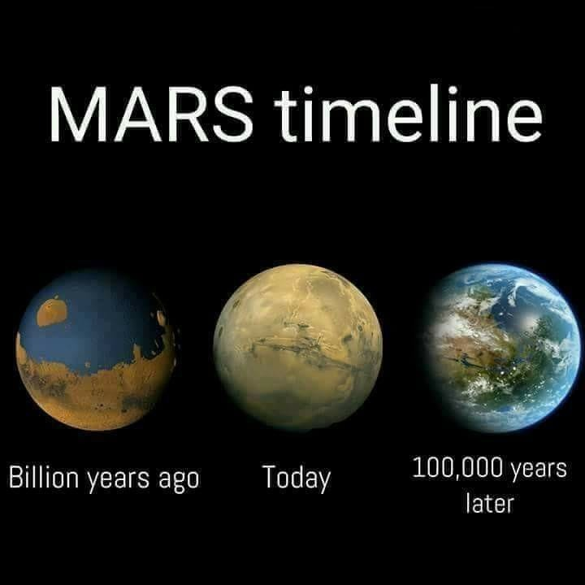
FUTURE
“After months of travel in space, when you first arrive at Mars and your new home is ready for you to move in, it will be a great day,”

Slide 13
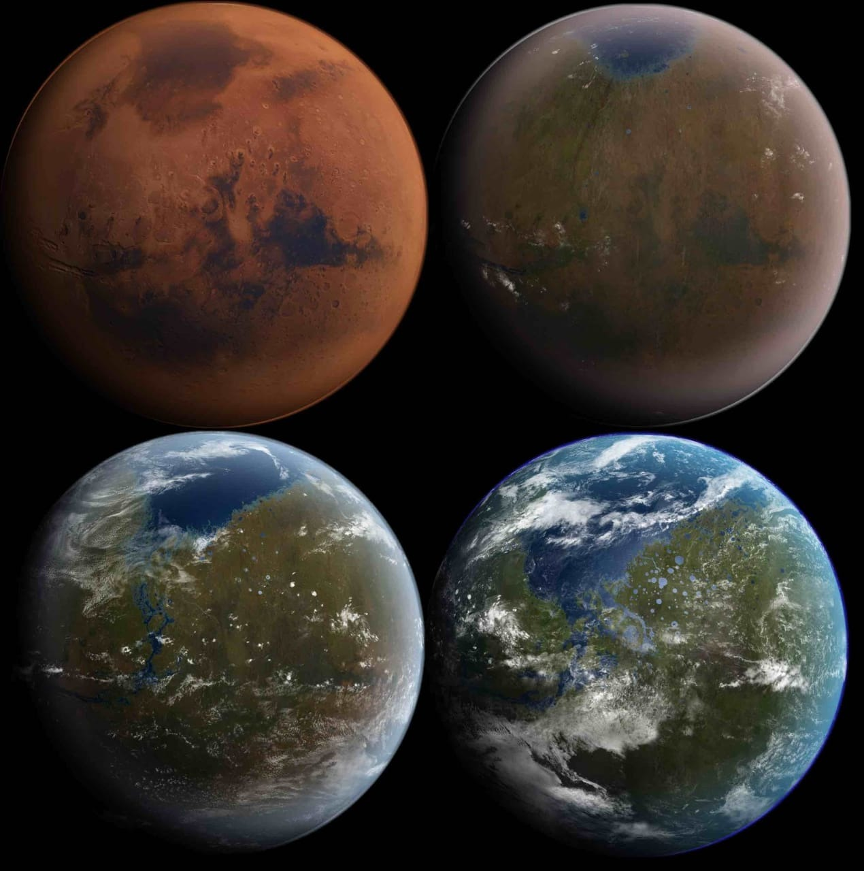
In November 2015, Administrator Bolden of NASA reaffirmed the goal of sending humans to Mars. He laid out 2030 as the date of a crewed surface landing, and noted that planned 2020 Mars rover would support the human mission.

Slide 14
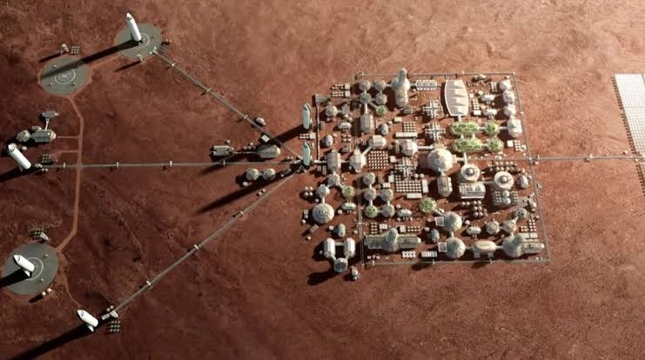


Slide 15
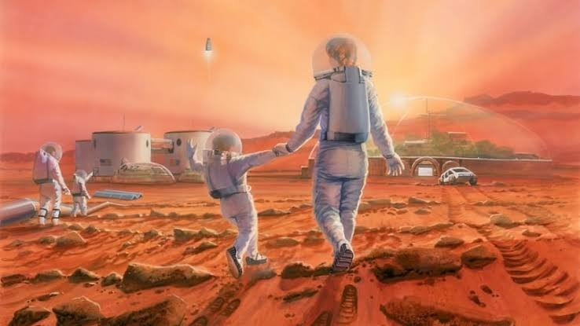

Slide 16


